Slide 1
Developers Collaboration Platform

Slide 2
Project Description
A developer-focused platform designed to connect programmers, share open-source or freelance projects, and foster teamwork across diverse software development tasks.

Slide 3
Problem Statement
Creating a niche platform designed to connect programmers who share specific project development goals, or for developers working on a particular project for a defined period. It helps them communicate in real-time, share files, and provide project-specific details seamlessly.

Slide 4
Solution
DevSearch provides a dedicated hub for developers:
Create detailed developer profiles
Share and collaborate on projects
Network through direct messaging
Manage teams efficiently

Slide 5
Key Features Implemented
User Profiles: Displays user profiles that showcase user-specific skills & expertise
Search & Tags: The platform is designed to help match developers by skills or interests
Messaging System: It includes a built-in inbox for enabling private messaging between developers
Team Management: Organize collaborators easily

Slide 6
Tech-Stack Utilized
Backend: Django + Django Rest Framework
Celery + Redis: Handle background tasks like email notifications & profile automation
GraphQL (Graphene): Flexible querying alongside REST APIs
Frontend: HTML, CSS, JavaScript
Database: MySQL (production), SQLite (dev)
Authentication: JWT via DRF Simple JWT
API Testing: Postman & Curl enabled
Containerization: Docker & Docker Compose for scalable and reproducible deployments

Slide 7
Deployment
The platform is hosted on PythonAnywhere for easier accessibility and ability to Support future scaling with containerized services. The platform can be extended to mobile and external client apps.

Slide 8
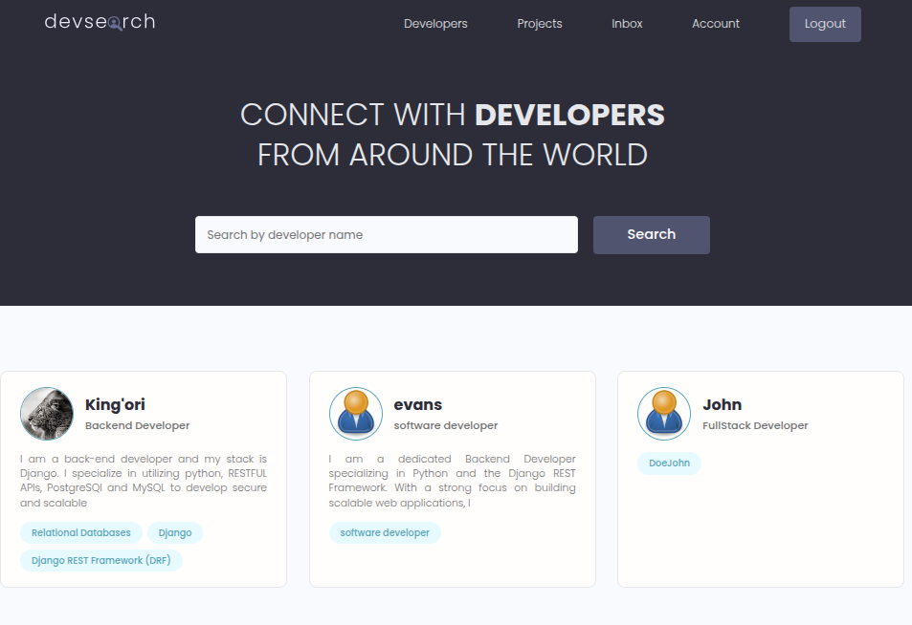
Visual Reference- Profiles Page

